Slide 1

MANGA/ANIME TRACKER
TEAM HASHEDIN
-Subramanya KN
-Yashwanth MR
-Shreenidhi TH
-Shreya RM

Slide 2




HOW DO I TRACK MANGA AND ANIME??
We read a lot of manga comics daily and watch anime !
But how to track them based on our activity and get back on the same page or the episode??

Slide 3

Manga/Anime tracker is an App that allows you to keep track of the manga you're reading online, as well as keeping a record of all the mangas you've read, and notifying you when they're updated.
Track latest episodes of anime you are watching
If you often forget what is the last episode you watched on specific anime you can use this app.It saves latest episode of every anime you watched, you can easily come back to that episode and watch next.

Slide 4
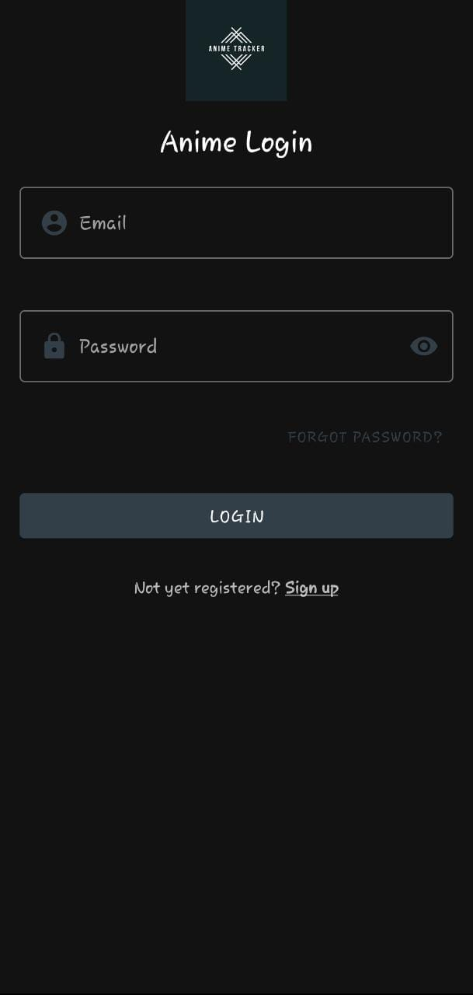
OUTPUT:
LOGIN PAGE:
You have to login through your emailID and password to access the app where you can sign up or you can reaccess your forgotten password through simple steps.

Slide 5
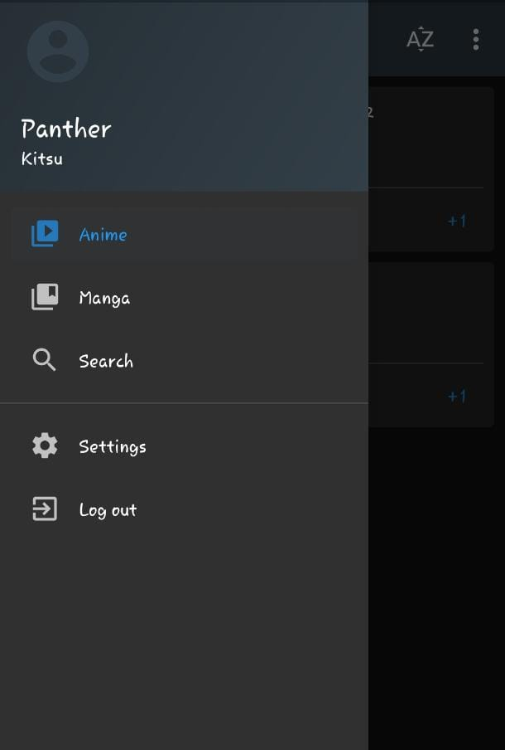
MENU PAGE
In this page you can access your profile, you can switch between the manga or the anime and also we can search any anime or manga
We can also access the settings and the user has the option to logout from his account

Slide 6
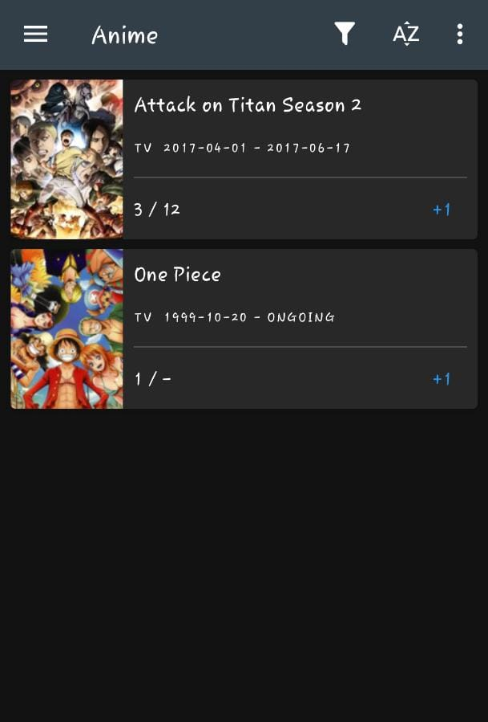
HOME PAGE
In this page we can get the list of the anime and manga that the user has imported or manually updated his list
The user can also increment the chapters or episodes using a +1 increment

Slide 7
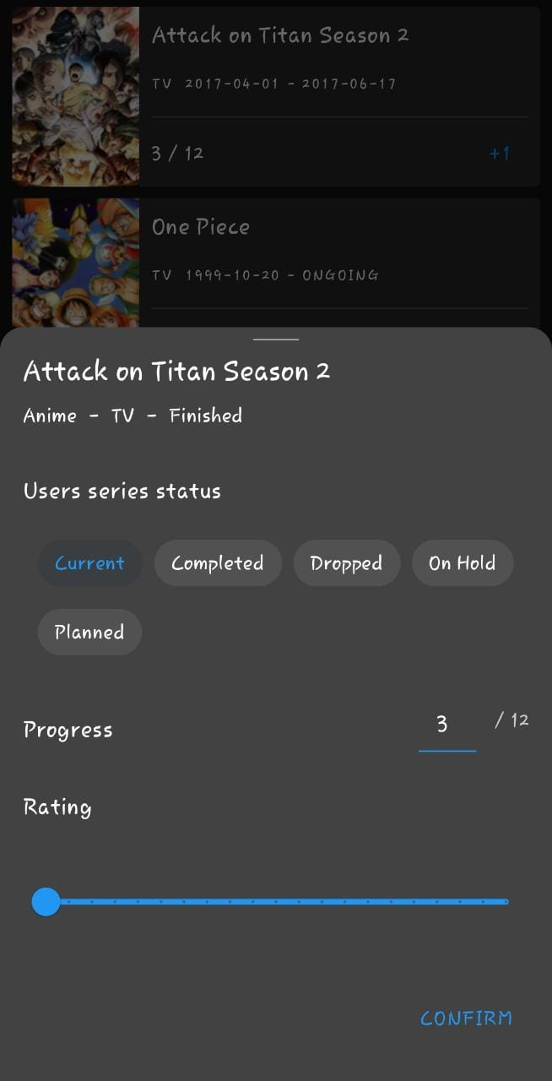
INFO PAGE
In this page the user can keep record of the anime or the manga that he may have watched or read
The user can categorize or set the status as watched/ dropped / completed /planning

Slide 8
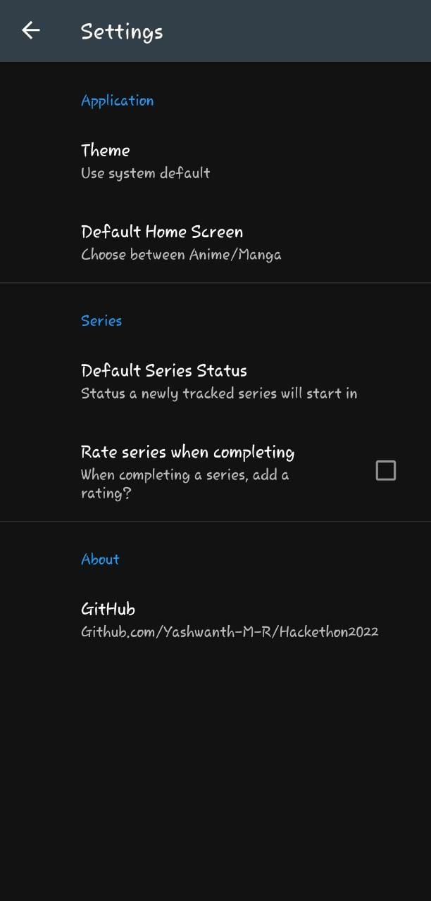
SETTINGS PAGE
This is the settings page where we can change different things according to our wish in the app like theme,default home screen,defauly series status and rate the series when completed

Slide 9
CONTENTS USED IN THE APP
🎨 Pattern
Jetpack Compose Apps
Model View ViewModel (MVVM)
Normal
Clean Architecture
Model View Intent (MVI)
Normal
Clean Architecture
Model View Presenter (MVP)
Model View Controller (MVC) and Other Patterns
📚 Tech Stack/Libraries
📝 Contributing
🗿 Core Contributors

Slide 10
CONTENTS
1) Awesome Jetpack Compose Android Apps aims to be the starting point for developers to find an Android app with a Jetpack Compose suite of libraries.
2)MODELVIEW VIEW MODEL(MVVM)
-PLEES TRACKER - This is meant to be a very simple open source clone of PrimeNap, i.e. just track sleep start/stop times and count the average / day.
Fenix (internal codename) is the all-new Firefox for Android browser, based on GeckoView and Mozilla Android Components.

Slide 11
-Pokedex using the PokeAPI for constructing RESTful API. PokeAPI provides a RESTful API interface to highly detailed objects built from thousands of lines of data related to Pokémon.
-Showly 2.0 is modern, slick, open source Android TV Shows Tracker.
-Nekome is an Android application that helps with tracking your anime and manga watch lists. Watch list data is handled by Kitsu.
-NotyKT is the complete Kotlin-stack note taking application built to demonstrate a use of Kotlin programming language in server-side and Modern Android development tools. Dedicated to all Android Developers with
-Vocable AAC allows those with conditions such as MS, stroke, ALS, or spinal cord injuries to communicate using an app that tracks head movements, without the need to spend tens of thousands of dollars on technology to do so.
-GIT EXPLORER - The app in itself is a simple git commands searching app. Selecting command from the dropdown list gives you the usage and short description of that command.

Slide 12
* Clean Architecture
The main objective is to achieve with the least amount of code RUDT principles which means that the code must be easy to:
Read
Update
Debug
Test (Unit & UI)
3) MODEL VIEW INTENT(MVI)
* Normal
-GameDealz is a non-official client for IsThereAnyDeal.com, it uses its API to retrieve/search for deals and compare prices.
* CLEAN
This project contains an implementation of the Componentization idea as shown by the UI Engineering team at Netflix.
Clean Architecture which is also known as Domain-Driven Design has evolved with considerable improvements in the last several years

Slide 13
4) MODEL VIEW PRESENTOR(MVP)
Tachiyomi
Tachiyomi is a free and open source manga reader for Android 6.0 and above.
The sample app that demonstrates using Clean Architecture + MVP.

Slide 14
CONCLUSION
WE CAN TRACK THE ANIME AND THE MANGA BY USING THE LIVE DATA THAT WILL BE TAKEN FROM THE ONLINE WEBSITES TO IMPLEMENT IT TO THE APPLICATION .

Slide 15


